Slide 1
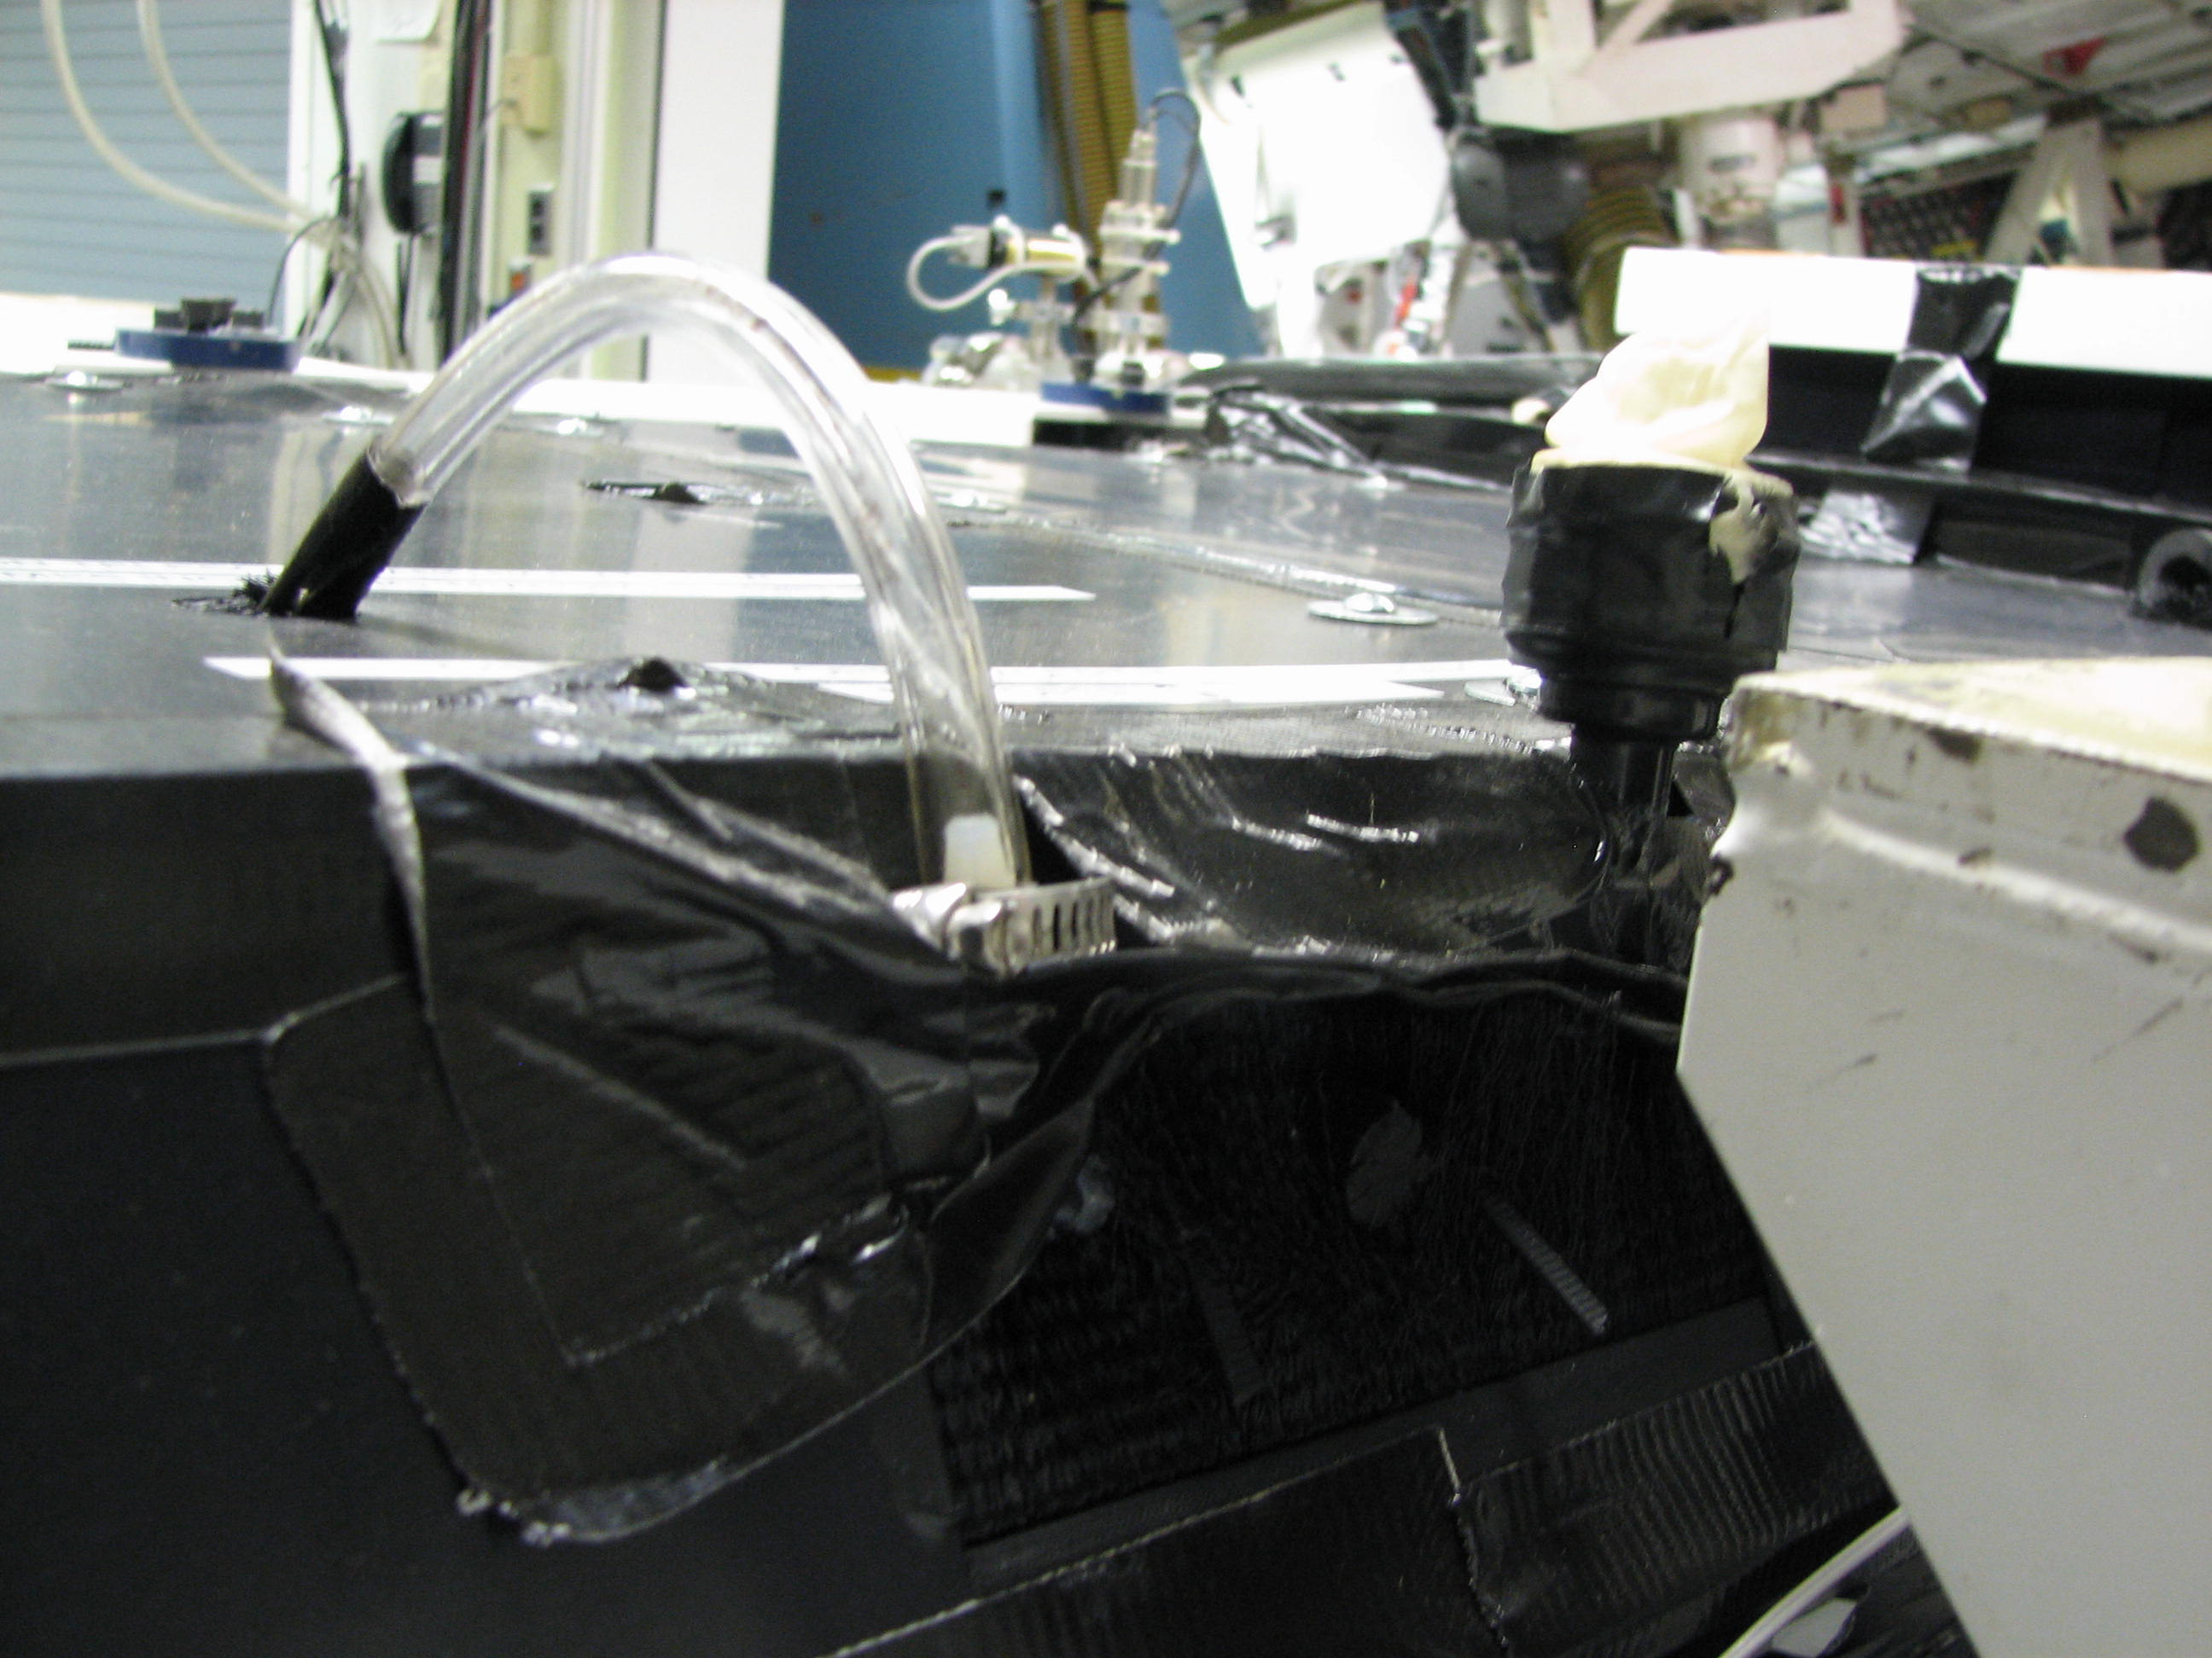
Finger Cot
Tube from
triplet
Spigot is located
here

