Slide 1
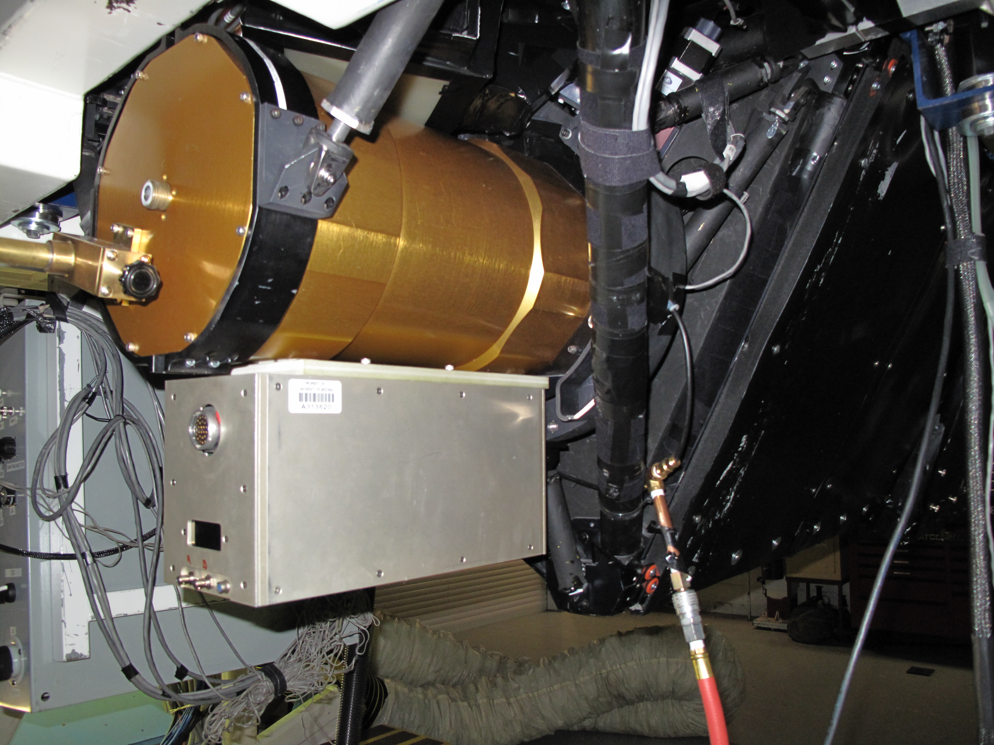
LN2 in
here
Vacuum
Pump
fitting
CCD Controller
electronics

