Slide 1
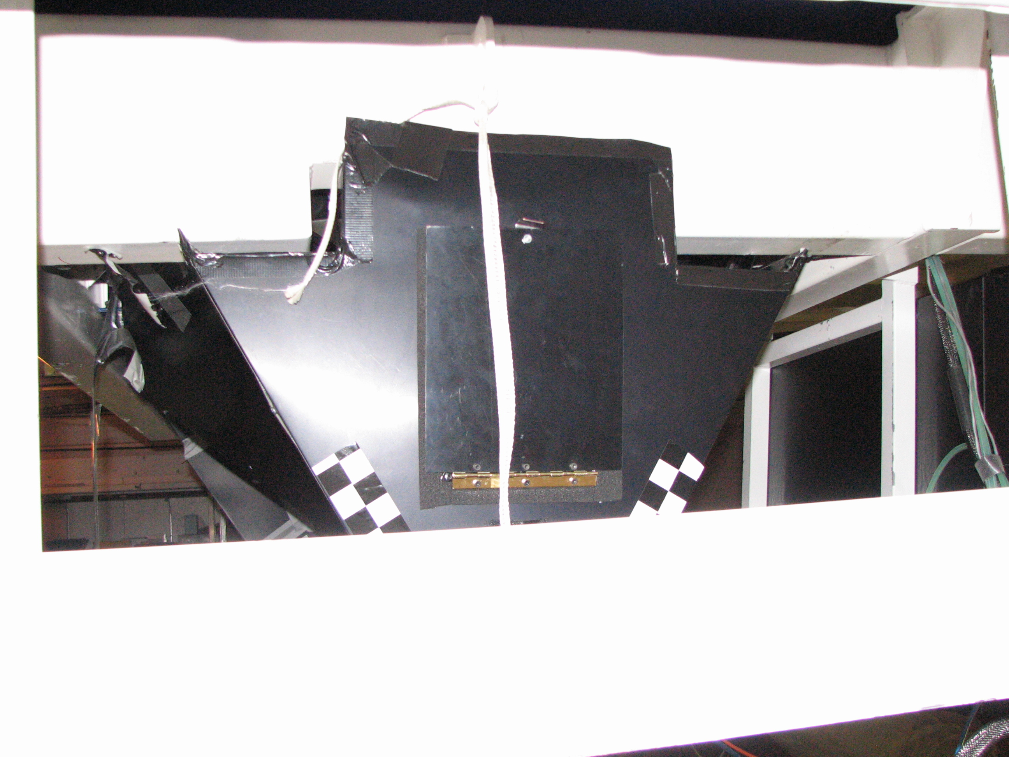
Door to access
dewar
Counterweights

