Slide 1
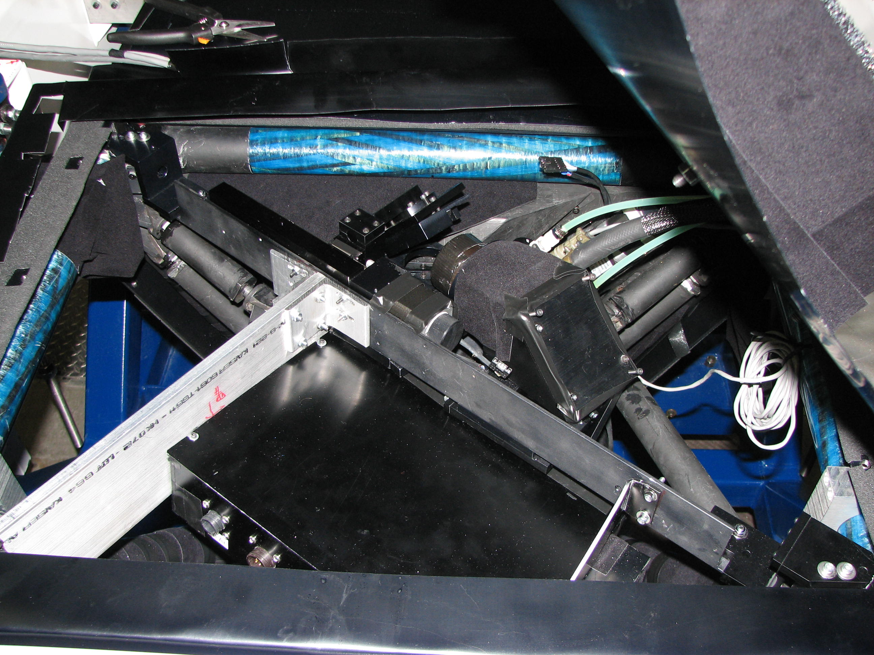
New Flip mirror bracket
Cal box

