Slide 1
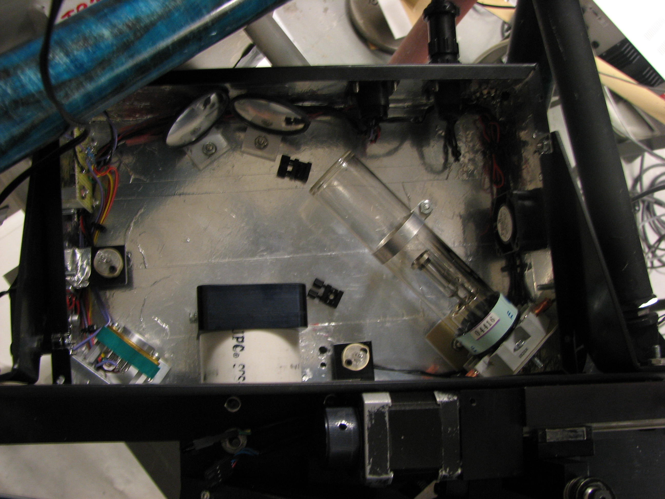
Thorium
Argon
Hollow
Cathode
Filter
holders
Quartz
Diffuser
UV LEDs
(not used)
Quartz

